Slide 1



Department of Computer Science and Engineering
23CS1512 - SOCIALLY RELEVANT MINIPROJECT
MICROFINANCE LOAN REPAYMENT PREDICTION USING MACHINE LEARNING
COORDINATOR: Mr.C.ELANGOVAN
GUIDE: Mrs.M.S.VINMATHI
TEAM MEMBERS:
POOJASHREE K [211423104459] PRAISY V [211423104466]
BATCH – D19

Slide 2
ABSTRACT
Microfinance provides small loans to communities, improving financial access and supporting livelihood opportunities.
Loan defaults are a major challenge, reducing sustainability and increasing risks for microfinance institutions.
Traditional evaluation methods rely on limited credit history and manual checks, often leading to inaccuracies.
This project applies Machine Learning algorithms to predict loan defaults using borrower and socio-economic data.
The system improves accuracy, reduces financial losses, and promotes sustainable rural development.

Slide 3



SUSTAINABLE DEVELOPMENT GOAL (SDG)
TARGET FOR THIS PROJECT
SDG 1: No Poverty
By enabling Microfinance Institutions (MFIs) to safely expand services and provide microloans that support income generation.
SDG 8: Decent Work and Economic Growth:
By promoting responsible, data-driven lending, which stimulates local economic activity and job creation in rural areas.
SDG 10: Reduced Inequalities:
overcomes financial exclusion by offering an objective, non-traditional credit scoring method, enabling MFIs to fairly assess underserved rural applicants regardless of formal banking history.

Slide 4
PROBLEM STATEMENT
Social Problem Being Addressed:
Many people take small loans from microfinance companies. But many of them are not able to repay the loan on time. This happens because there is no smart way to check who can repay and who cannot. Most villagers do not have a credit score or bank history.
Who Is Affected & How:
Villagers are affected because they don’t get loans easily or have to pay more interest.
Loan companies are affected because they lose money when people don’t repay. This creates a big gap between poor people and financial services.
One-Line Problem Statement:
There is no proper system to check loan repayment risk, which causes more loan failures.

Slide 5
LITERATURE REVIEW
S.NO | PUBLICATIONS | INSIGHTS | METHODS USED | RESULTS
1 | Loan Default Prediction Using Machine Learning Techniques | The paper discusses the prediction of loan defaulters using machine learning techniques such as KNN and Decision tree models. | Data Collection and Data Cleaning | KNN model performs better than Decision tree model Loan default prediction techniques are effective
2 | Loan Risk Prediction based on Random Forest Model | The paper uses a random forest classification model to predict the possibility of loan default with an accuracy of 85.62%. | Random forest classification model Linear regression (mentioned but not used). | Test accuracy: 85.62% F1-score: 85.48%
3 | An active learning application on loan default prediction: based on forest classifier model | Active learning application for loan default prediction using a random forest classifier model with high accuracy and improved efficiency. | Random forest classifier model Active learning strategy | Random forest classifier achieves 93.2% accuracy in loan default prediction. Active learning strategy improves efficiency by 7% with 50 labelled data.
4 | Loan Prediction Using Machine Learning Methods | Loan prediction using machine learning algorithms such as decision tree, random forest. | Decision tree Random forest Logistic regression | Decision tree Random forest Logistic regression

Slide 6
BASE PAPER
Base Paper Title: “Bank Loan Default Prediction Using Machine Learning”
Authors:
Muhammad Zunnurain Hussain et al. (IEEE I2CT 2024)
Key Learnings:
Machine Learning improves credit risk prediction over traditional scoring models using Random Forest and Gradient Boosting.
Data preprocessing and feature engineering help optimize model accuracy and performance.
Hyperparameter tuning enhances results, making the model suitable for real-world integration.
Gap Identified:
Most existing models are urban-focused or lack rural borrower features.
Very few are tested on real-world rural Indian datasets or consider informal economic behavior.
Does not use SHAP, LIME, or similar for model interpretability.

Slide 7
EXISTING SYSTEM
Description of Current Manual System:
Loan approvals are done manually.
Processing involves paperwork and personal visits to microfinance offices.
Risk assessment is done after loan disbursement, not before.
Limitations & Problems Faced:
processing due to manual work.
Prone human errors in data handling.
No predictive mechanism to evaluate repayment capability.
Higher loan default rates for villagers without credit history.
Financial loss for microfinance companies.
Inefficient access to loans for poor rural borrowers.

Slide 8
PROPOSED SOLUTION & SYSTEM
Proposed Solution:
We propose a machine learning-based system that predicts loan default risk using non-traditional data like occupation type, previous repayment behavior, income, and family size.
This will help microfinance institutions make informed loan decisions, reduce defaults, and promote financial inclusion.
Proposed System:
Automatically predicts loan defaults in advance, making the process faster and more accurate.
Reduces human bias in loan approvals and Provides data-driven insights for better loan management.
Improves accessibility of loans for villagers with limited financial history.
Feature | Existing System | Proposed System
Method | Manual / Traditional | Machine Learning based
Speed | Slow | Fast and automated
Accuracy | Low, error-prone | High, data-driven
Risk Assessment | Reactive | Predictive
Bias | Human bias present | Reduced bias
Monitoring | Post-default | Preemptive & continuous

Slide 9
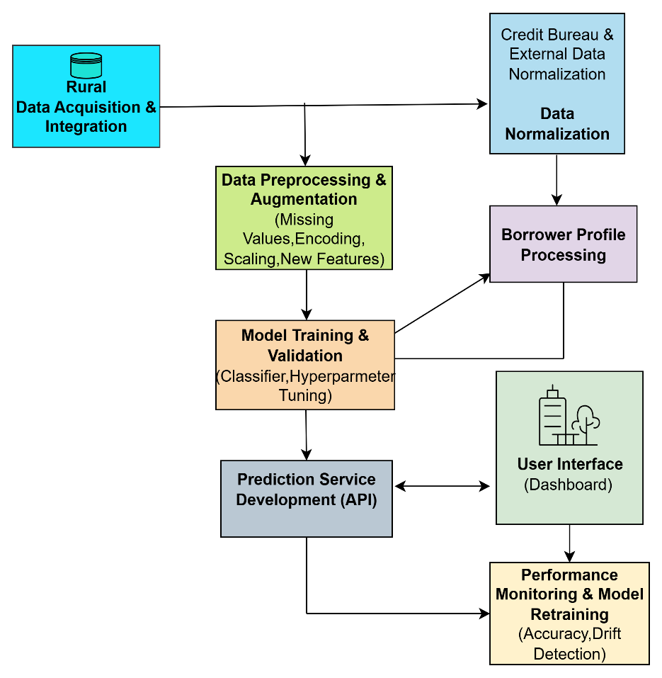
ARCHITECTURE
Smart Data Preparation: Data is thoroughly cleaned, normalized from external sources, and processed to create powerful New Features before modeling begins.
Prediction Core: The system builds the optimal model through Training & Validation and exposes its results instantly via a dedicated Prediction Service API.
Real-time Visibility: Results are channeled into a Borrower Profile and displayed on the User Interface for immediate use by loan officers.
Automated Reliability (MLOps): Continuous Performance Monitoring detects drift in model accuracy and automatically triggers Model Retraining.

Slide 10
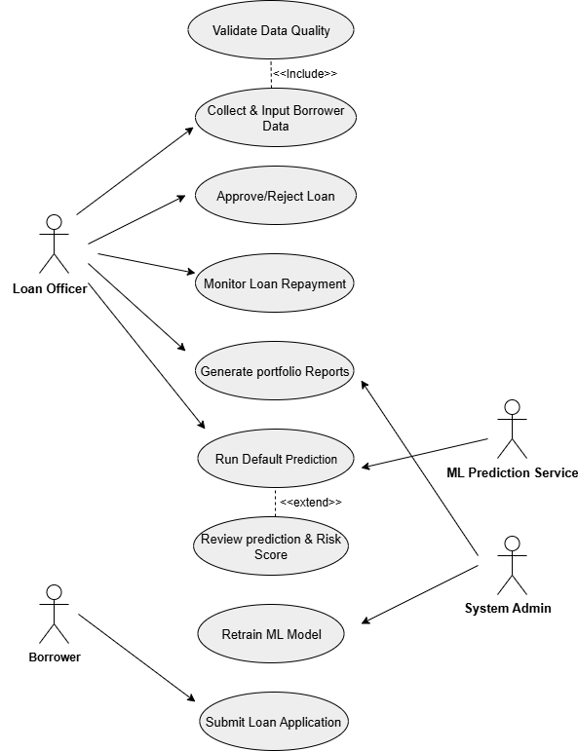
USECASE DIAGRAM
Handle Loan Applications: The system manages everything from the borrower submitting the application to the final approval or rejection.
Predict Risk: It uses a machine learning model to check data quality and calculate a risk score (default prediction).
Track Loans: The system monitors active loans and generates reports on the entire loan portfolio's performance.
Keep Model Accurate: There's a function to retrain the ML model, ensuring predictions stay reliable over time.

Slide 11
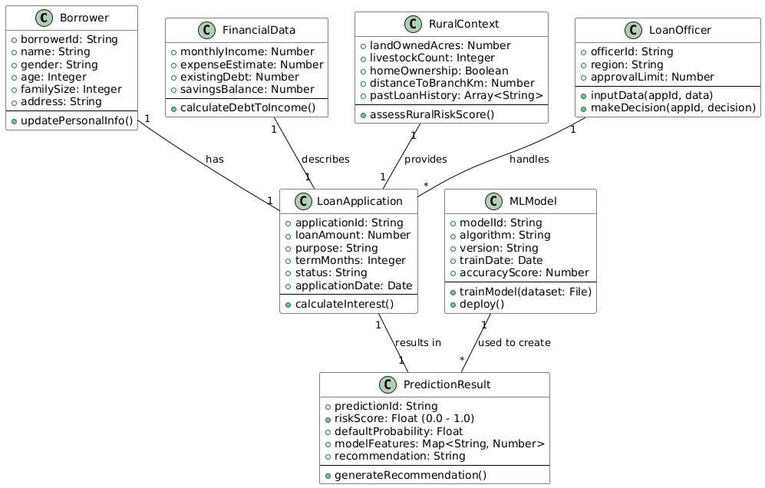
CLASS DIAGRAM
Core Application: The central LoanApplication class links the Borrower data with all assessment factors.
Assessment Data: The system uses two types of data: FinancialData (income, debt) and RuralContext (land, livestock) for comprehensive assessment.
Risk Prediction Engine: The MLModel class processes the application data to create the PredictionResult (including risk score).
Human Interaction: The LoanOfficer handles the application and uses the system to makeDecision.

Slide 12
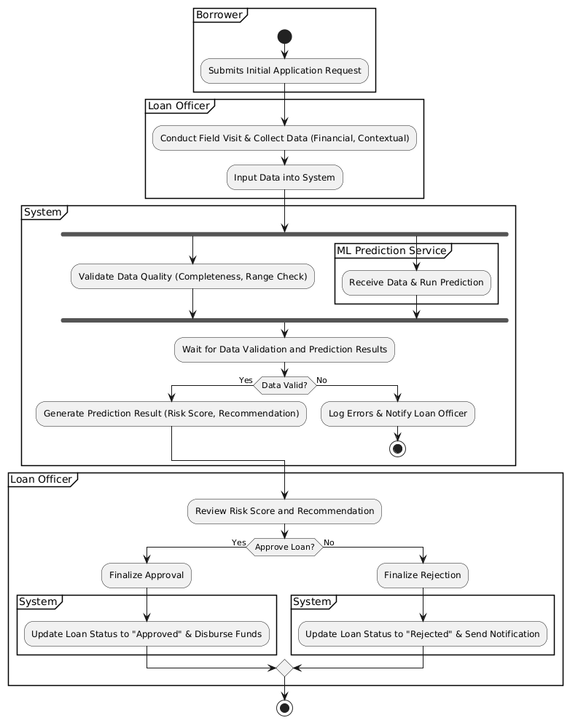
ACTIVITY DIAGRAM
Initiation & Data Collection: The process starts with the Borrower submitting the Request. The Loan Officer then gathers and inputs all required data after a field visit.
Automated Dual Check: The System simultaneously runs Data Quality Validation and initiates the ML Prediction Service to calculate the risk score.
Risk-Informed Decision: Based on the results, the Loan Officer reviews the Risk Score and Recommendation to decide whether to approve or reject the loan application.
Finalization & Status Update: The System automatically finalizes the decision, either by Updating Loan Status to "Approved" and Disbursing Funds or by updating the status to "Rejected" and sending a notification.

Slide 13
HARDWARE & SOFTWARE REQUIREMENTS
HARDWARE REQUIREMENTS :
Processor: Intel i5/i7 or AMD Ryzen 5/7
RAM: 8 GB (16 GB recommended)
GPU: NVIDIA GPU (optional, for faster ML training)
Storage: 256 GB SSD minimum
SOFTWARE REQUIREMENTS :
Programming Language: Python 3.9+
Framework: Flask
Libraries: Pandas, NumPy, Scikit-learn, Matplotlib, SQLAlchemy
Development Tools: Jupyter Notebook / VS Code, GitHub for version control
Operating System: Windows 10/11, Linux Ubuntu, or macOS
Database: MySQL or SQLite

Slide 14
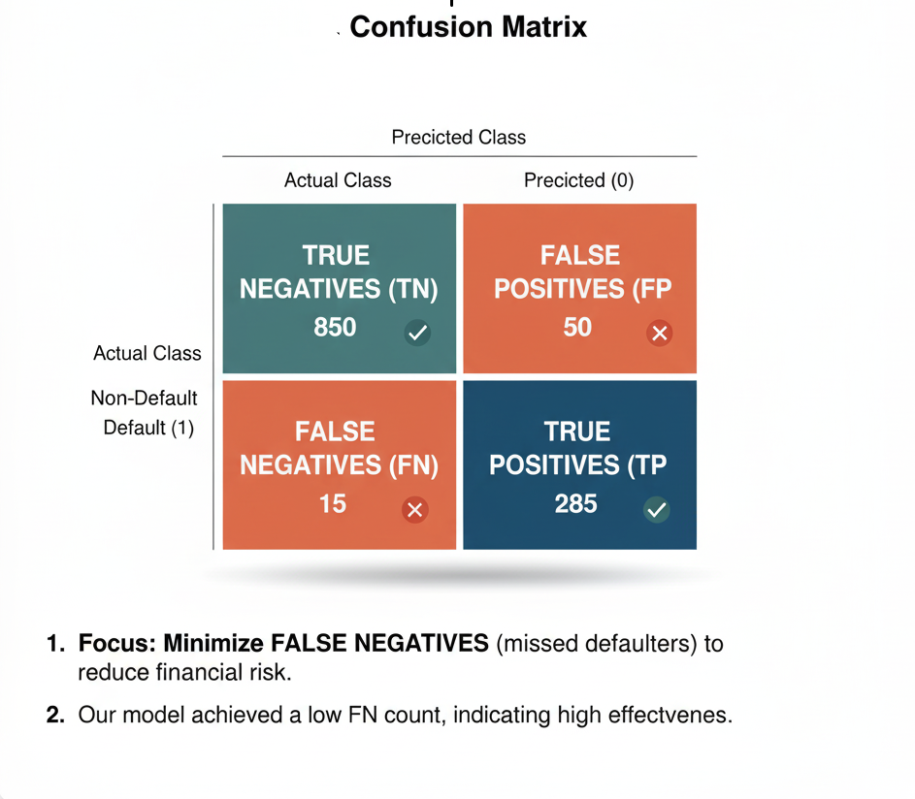
IMPLEMENTATION
# Import Gradient Boosting classifier
from sklearn.ensemble importGradientBoostingClassifier
from sklearn.model_selection import train_test_split
# Split data into training and testing sets
X_train, X_test, y_train, y_test = train_test_split(
X_scaled, y_target, test_size=0.3, random_state=42, stratify=y_target
)
# Initialize and train the Gradient Boosting model
grad_model = GradientBoostingClassifier(
n_estimators=150, # Number of boosting stages
max_depth=5, # Maximum depth of each tree
learning_rate=0.05, # Step size shrinkage
random_state=42
)
grad_model.fit(X_train, y_train)
# Make predictions
predictions = grad_model.predict(X_test)
Metric | Result | Business Implication
Model Used | Optimized Gradient Boosting Classifier | Chosen for sequential error correction, iteratively builds a strong model by minimizing residuals.
Accuracy | 91.5% | Overall prediction correctness.
Recall | 95% | The model successfully identifies 95 out of every 100 actual defaulters.
Precision | 88% | When the model predicts a default, it is correct 88% of the time.

Slide 15
TESTING
Testing Types:
Unit Testing: Verifies individual modules before integration and handles missing values.
Integration Testing: Checks smooth data flow from preprocessing → ML prediction → UI display.
Functional Testing: Verifies system meets business & technical requirements, ensures accurate risk scoring.
System Testing: Evaluates performance, stability, concurrent request handling, and security (HTTPS/SSL).
User Acceptance Testing (UAT): Loan officers test Dashboard usability, risk clarity, and feature explanations.
Test Cases:
TEST ID | SCENARIO | EXPECTED RESULT | STATUS
TC01 | Valid Input | Low Risk score in <1 sec | Pass
TC02 | Invalid Input | Error message displayed | Pass
TC03 | Known HighRisk | High Risk tag predicted | Pass
TC04 | Latency | Prediction < 1 sec | Pass

Slide 16
MODULE -1
MODULE 1: USER MANAGEMENT
Description:
Manages secure user registration, login, and role-based authentication for admins and loan officers.
Ensures data privacy by assigning specific access permissions to each user role.
Uses encryption and session control to protect credentials and prevent unauthorized access.
Key Features:
Secure login and registration using authentication protocols.
Role-based access for admins and officers.
Session management and logout control.
Encrypted password storage for enhanced security.
An illustration showing user authentication flow — 👤 User → 🔒 Login Form → ✅ Server Verification → 🏠 Dashboard

Slide 17
MODULE - 2
MODULE 2: DATA PROCESSING & FEATURE ENGINEERING
Description:
Gathers borrower details such as income, occupation, repayment history, and socio-economic factors.
Cleans and prepares data by handling missing values, encoding categorical features, and normalizing numeric fields.
Ensures high-quality, consistent data ready for accurate machine learning predictions.
Key Features:
Automated data cleaning and transformation.
One-hot encoding for categorical data.
Standard scaling for numeric data.
Dynamic dataset updates through CSV uploads.
A data pipeline flow diagram — 📄 Raw Data → ⚙️ Preprocessing → 📊 Feature Engineering → 🧮 ML Model Input

Slide 18
MODULE - 3
MODULE 3: MACHINE LEARNING PREDICTION
Description:
Utilizes trained ML models to predict the likelihood of loan default based on borrower inputs.
Generates a risk score categorized as Low (≤40%), Medium (40–75%), or High (>75%), helping officers assess risk levels quickly.
Performs feature contribution analysis to highlight which borrower factors influenced the prediction, ensuring transparency and interpretability.
Key Features:
Predicts loan default probability in real-time.
Categorizes risk levels for decision-making.
Provides explainable AI insights (feature importance).
Continuously improves with retrained datasets.
An neural network visualization with arrows from “Input Data” → “Model” → “Risk Output (Low/Medium/High).”

Slide 19
MODULE - 4
MODULE 4: REPORTING & ANALYTICS
Description:
Displays prediction results, historical loan data, and risk distribution through dynamic dashboards.
Allows administrators to monitor trends, identify defaulted or Non- defaulted, and evaluate model performance.
Uses interactive visualizations and reports to support data-driven financial decision-making.
Key Features:
Visual dashboards with real-time analytics.
Risk trend charts and portfolio health tracking.
Exportable reports for business analysis.
Helps in strategic planning and performance evaluation.
A dashboard-style graphic — showing pie charts 📊, line graphs 📈, and risk distribution bars.

Slide 20
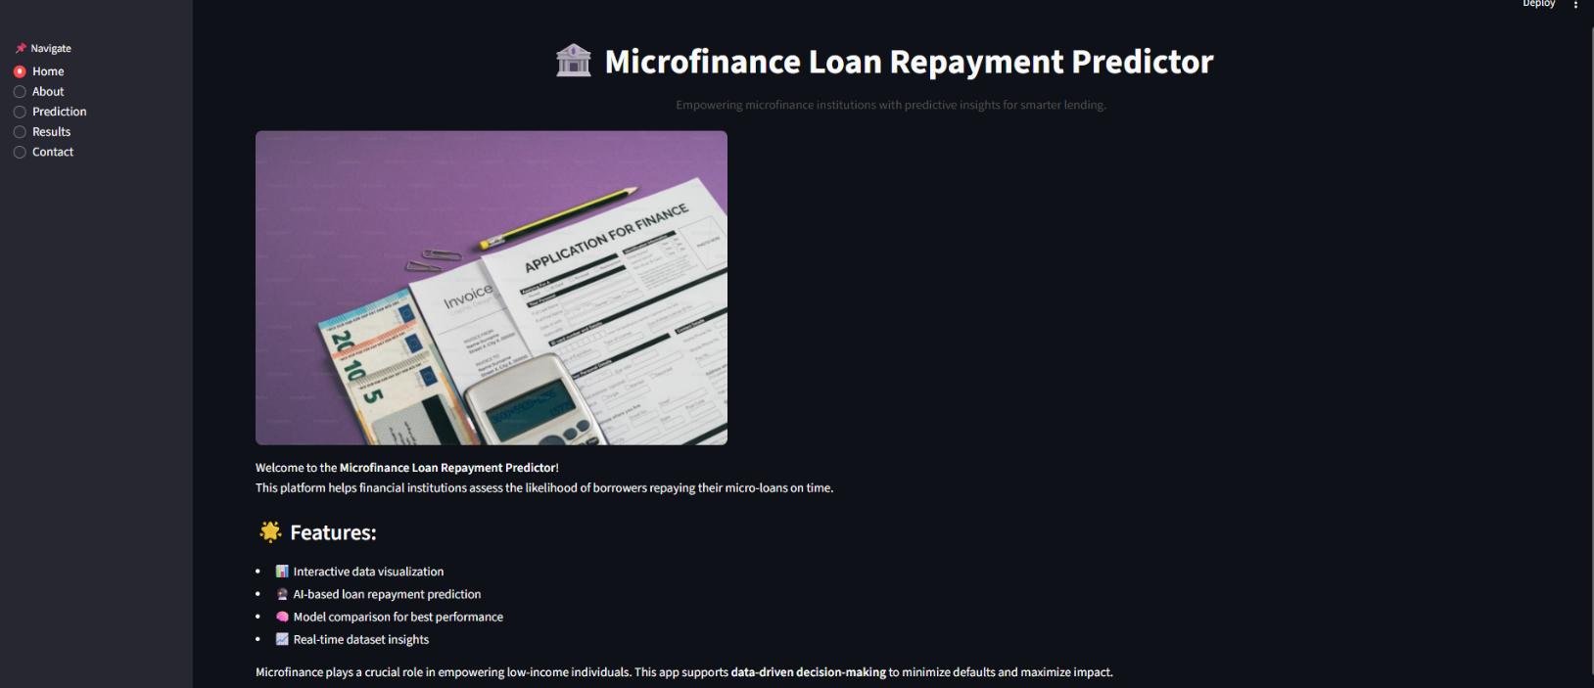
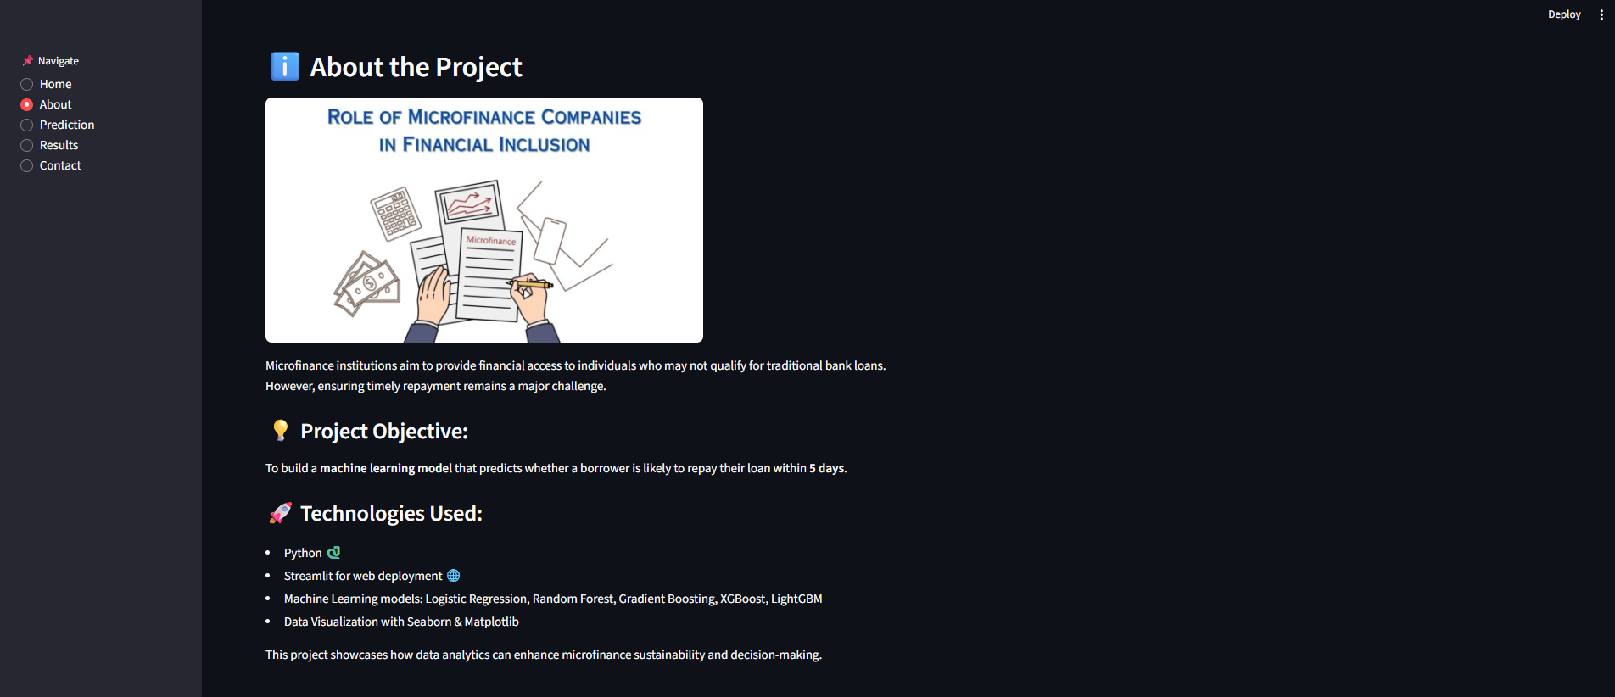
SCREENSHOTS

Slide 21
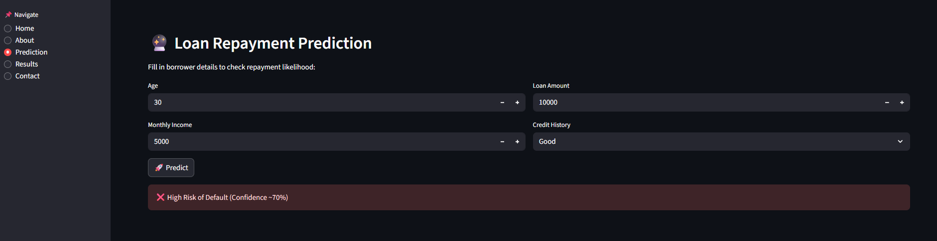
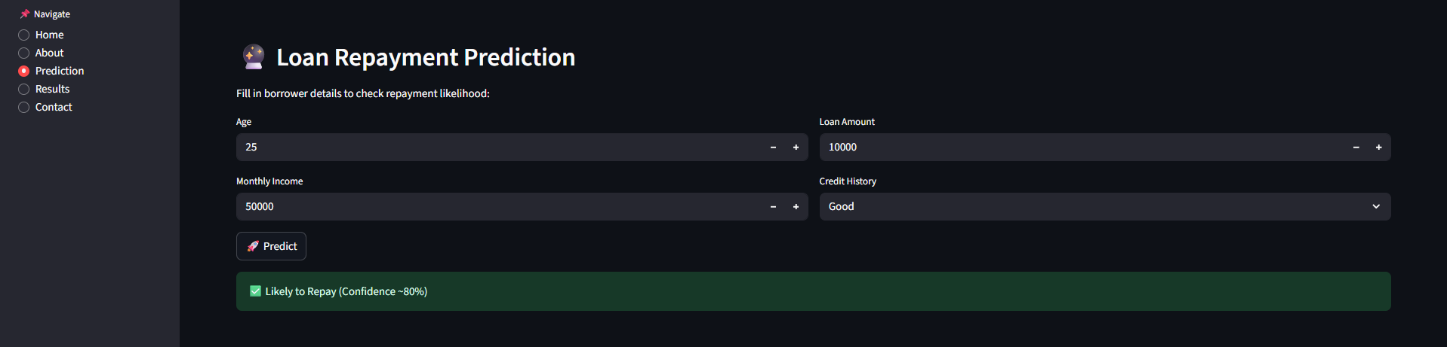
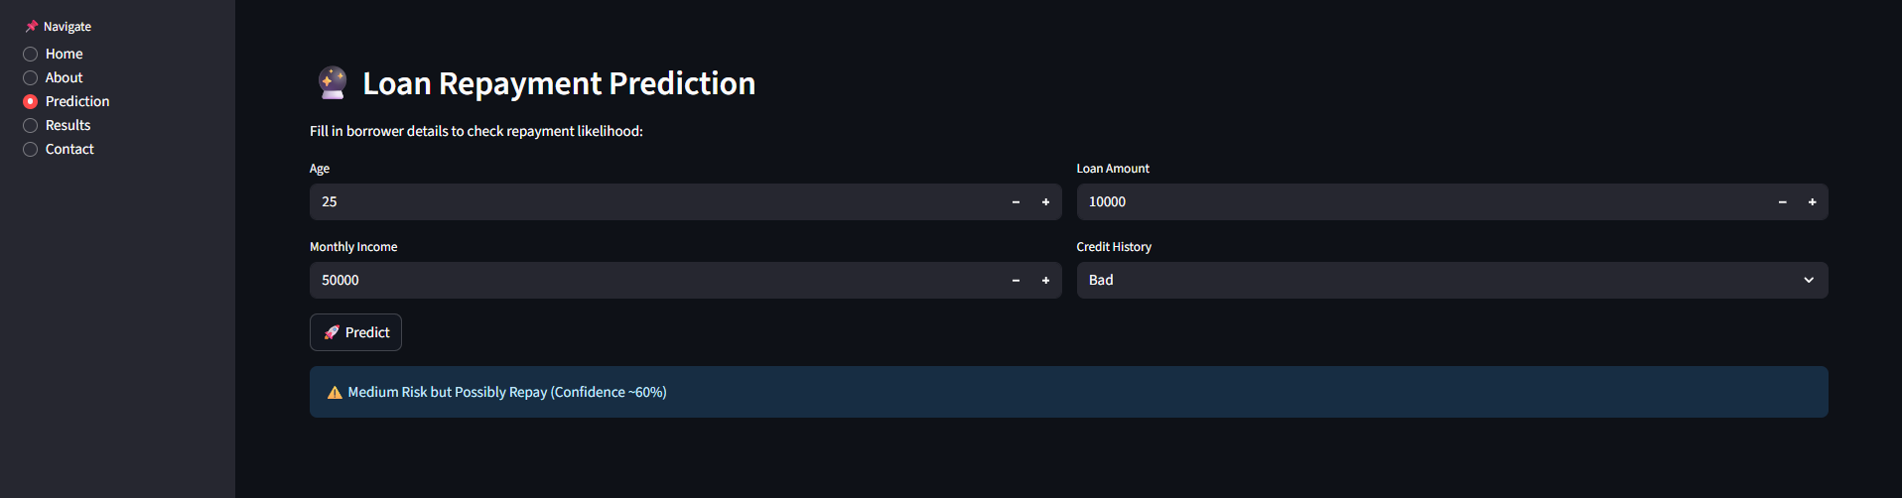
SCREENSHOTS

Slide 22
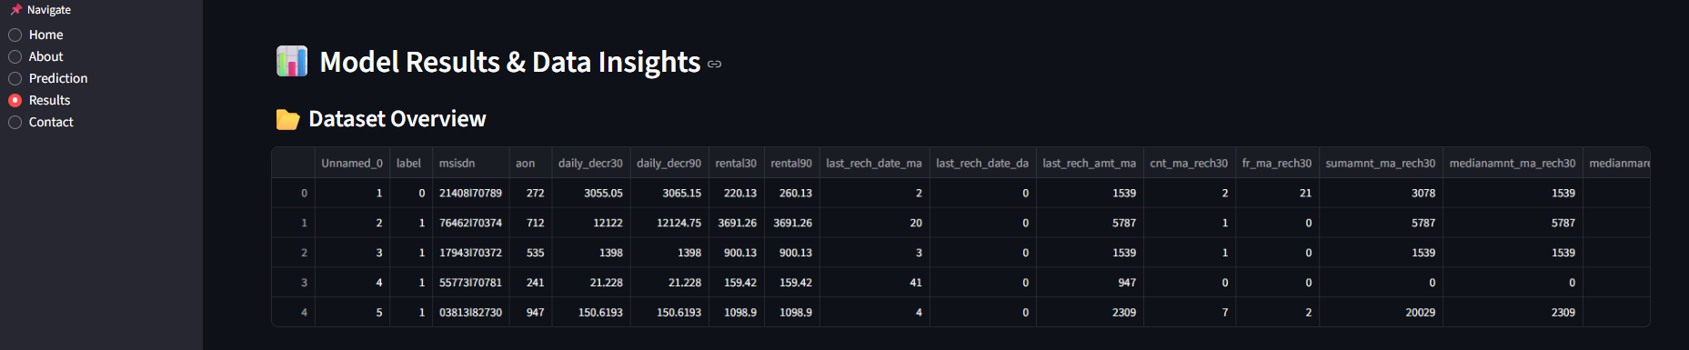
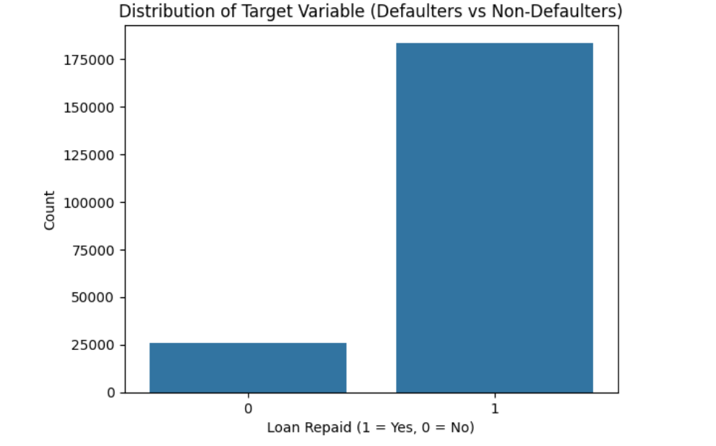
SCREENSHOTS

Slide 23
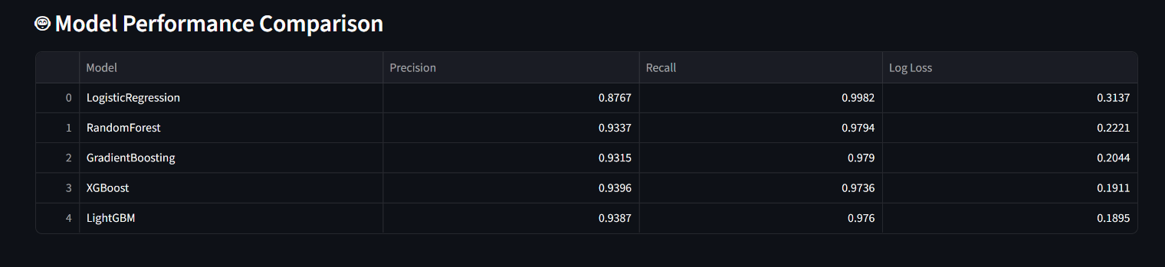
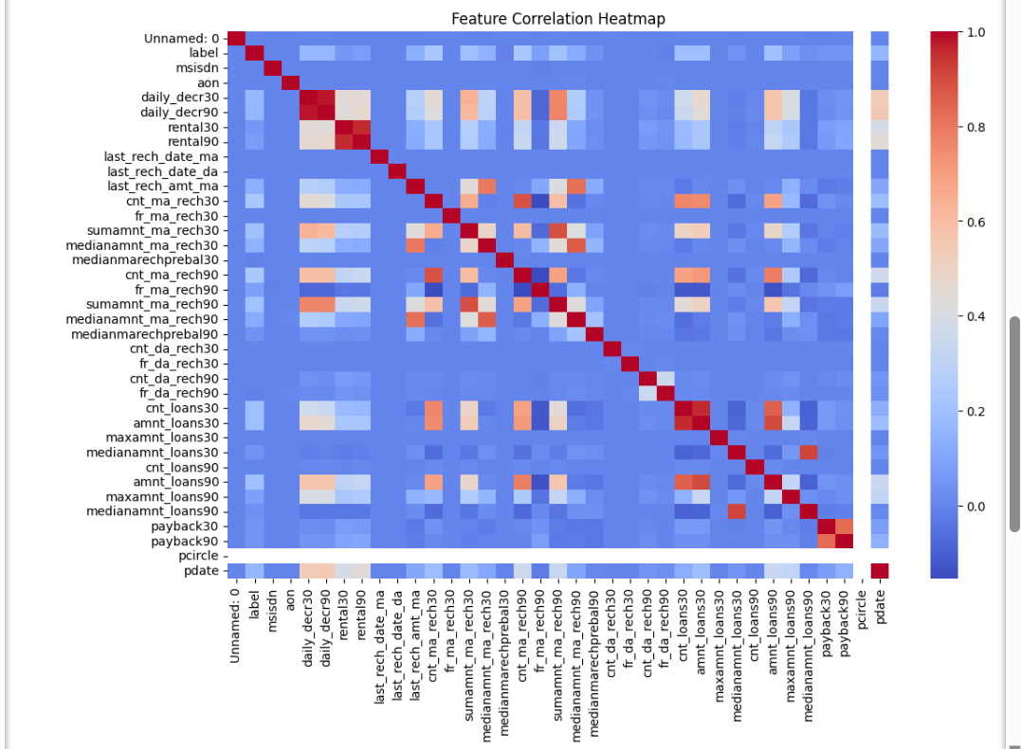
SCREENSHOTS

Slide 24
CONCLUSION & FUTURE ENHANCEMENTS
Conclusion
The proposed system efficiently predicts loan defaults using machine learning, reducing human errors and improving decision-making.
It provides data-driven insights, enabling rural microfinance institutions to assess risk proactively and manage loans effectively.
The system enhances accuracy, speed, and reliability compared to traditional manual methods.
Future Enhancement
Integrate advanced algorithms like XGBoost or Neural Networks for higher prediction accuracy.
Include real-time monitoring of borrower behavior for continuous risk assessment.
Extend the system to mobile platforms for easier access by rural officers in remote areas.
Incorporate additional socio-economic and behavioral features for more comprehensive risk evaluation.

Slide 25
REFERENCES
[1] M. Z. Hussain, et al., “Bank Loan Prediction System Using Machine Learning Models,” IEEE I2CT, 2024.
[2] S. Fan, “Personal Loan Default Prediction Using LightGBM,” IEEE ICPECA, 2023.
[3] P. Sanyal, et al., “Voting Ensemble Model for Credit Risk Prediction,” IEEE Conference, 2024.
[4] N. Innan, et al., “Loan Eligibility Prediction Using Quantum Neural Networks,” IEEE (Preprint), 2024.
[5] I. Emmanuel, et al., “Credit Risk Prediction Using Stacked Classifier and Feature Selection,” IEEE, 2025.
[6] A. Singh, “Application of Explainable AI in Loan Default Risk Assessment,” arXiv (Financial AI Research Group), 2024.
[7] R. Kumar, “Credit Scoring Models Using XGBoost and Random Forest: A Comparative Study,” Springer Journal of Financial Data Science, 2023.
[8] Y. Chen, “LightGBM-Based Loan Repayment Prediction for Microfinance Institutions,” Elsevier Journal of Applied Computing in Finance, 2024.

Slide 26
[9] F. Alvarez, “Deep Neural Networks for Credit Default Prediction in Emerging Markets,” IEEE Transactions on Computational Intelligence, 2023.
[10] J. Park, “Hybrid Ensemble Learning for Loan Repayment Prediction,” ACM International Conference on Data Science in Finance, 2024.
[11] Ampountolas, A., & Legg, M. (2021). A Machine Learning Approach for Micro-Credit Scoring. Risks, 9(3), 50. This paper compares various machine learning classifiers for micro-lending credit scoring when credit history is missing.
[12] Dashnyam, B., Uvgunkhuu, G.-O., & Sosorbaram, B. (2024). The Machine Learning Methods for Micro-Credit Scoring: The Case of Micro-Financing in Mongolia. Eduvest – Journal of Universal Studies, 4(6). Shows how Random Forest and XGBoost outperform for microloan repayment prediction.
[13] Kore, S., Khade, S., Sarkar, I., et al. (2025). A Survey on Loan Repayment Prediction Using Various Techniques. TIJER, Vol 12, Issue 6. A survey paper that reviews many ML methods (logistic regression, random forests, neural nets) in loan repayment prediction.
[14] Hu, X., Huang, Y., Li, B., & Lu, T. (2023). Inclusive FinTech Lending via Contrastive Learning and Domain Adaptation. arXiv preprint. Discusses bias and domain adaptation in micro/FinTech lending.

Slide 27
[15] Koffi, C. H. A., Biatat Djeundje, V., & Menoukeu Pamen, O. (2024). Emphasises how social/cultural factors affect repayment in microfinance contexts.
[16] “Leveraging Transactional Data for Micro and Small Enterprise Lending” (2024). CGAP Research. Highlights use
of alternative data (mobile/transactional) for credit scoring in emerging markets.
[17] Two‑class Bayes point machines in repayment prediction of low credit borrowers (Maloney, Hong & Nag, 2022) – Focuses on predicting loan repayment among low credit borrowers using machine learning approaches.
[18] Explainable prediction of loan default based on machine learning (2023) – Examines factors influencing loan defaults and emphasizes interpretability of ML models.
[19]. Credit risk assessment of small and micro enterprise based on machine learning (Gu et al., 2024) – Addresses credit risk for SMEs/micro-enterprises using ML and handling imbalanced data.
[20] Behavioral Patterns in Micro‑lending: Enhancing Credit Risk Assessment (Aldrees, 2025) – Proposes novel methods using collaborative filtering & behavioral data for micro-lending risk assessment.
[21] AI‑Based Credit Scoring Models in Microfinance (Rehman et al., 2025) – A review of AI/ML in microfinance credit scoring, discussing inclusion, risks, and ethics.

Slide 28
THANK YOU

